Slide 1

SIMPLE & OPTIMIZED ULTRASONIC WALL FOLLOW

Slide 2
Objectives
Learn how to use the ultrasonic sensor to follow walls
Learn how to optimize code
Prerequisites: Loops, Switches (If Then Blocks), Ultrasonic Sensor

Slide 3
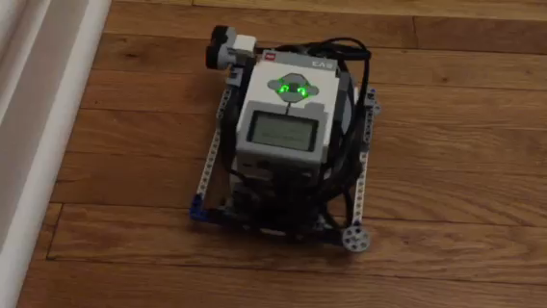
Challenge 1: Simple Wall Follow
Challenge: Can you write a program to have a robot follow the wall (always staying 15cm away from the wall) using an ultrasonic sensor?
STEP 1: In an If Then Else Block, turn Left or Right based on whether the robot is too close to the wall or too far from the wall
STEP 2: Repeat everything in a loop that runs forever (you can change the exit condition of the loop if you wish by switching out the loop block)
Play the video to see how the robot should move

Slide 4
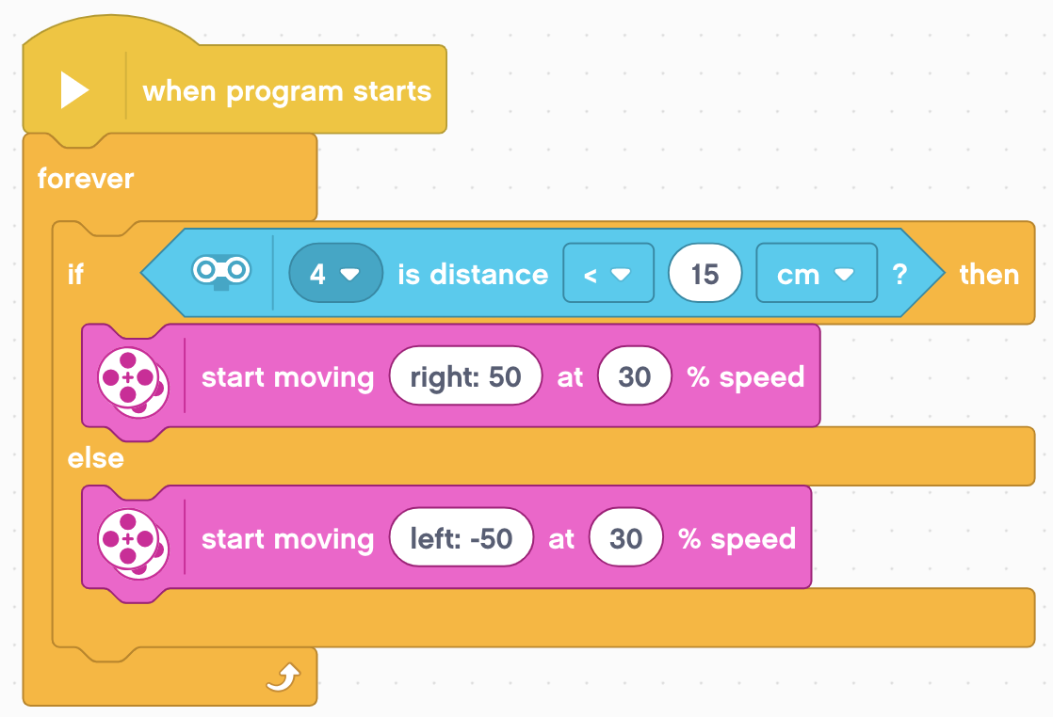
Challenge 1 Solution

Slide 5
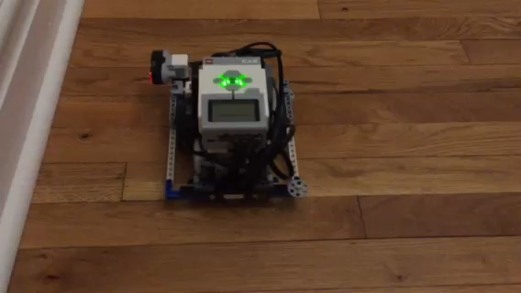
Challenge 2: Optimizing the Code
The code for the Simple Ultrasonic Wall Follow Challenge was slow and the robot wiggles back and forth a lot.
Challenge: For this next challenge, think about how you can improve the program so that the wall follower is smoother.
Hint: Change the angle of the turns
Play the video to see how the robot should move
Do you notice any differences?

Slide 6
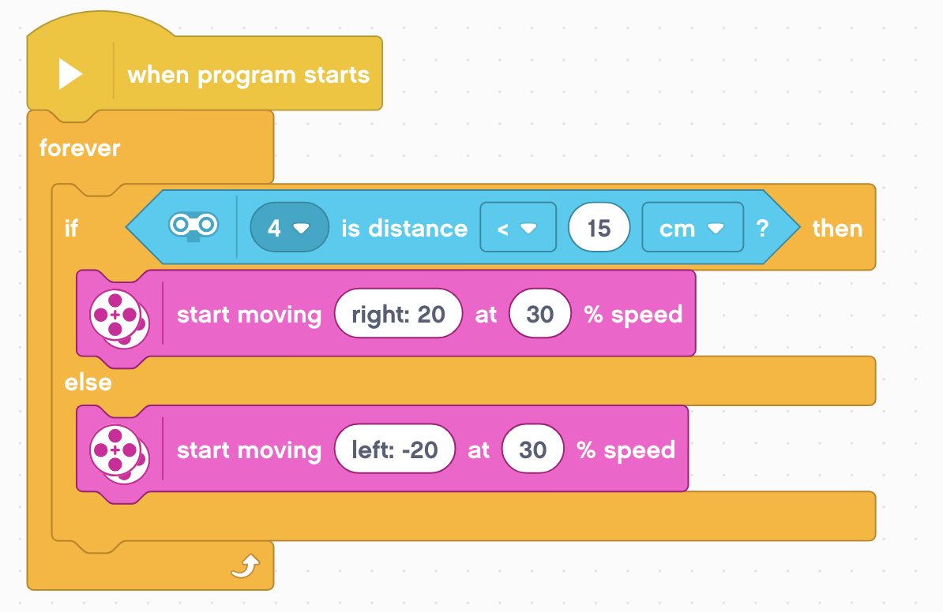
Challenge 2 Solution
The angle in the steering block is changed from 50 to 20 so that the robot curves instead of making sharp turns.

Slide 7
Credits
This tutorial was created by Sanjay Seshan and Arvind Seshan
More lessons are available at www.ev3lessons.com
This work is licensed under a Creative Commons Attribution-NonCommercial-ShareAlike 4.0 International License.

